Slide 1
CONSTRUCTOR

Slide 2
What is a Constructor?
First, by simply defining it inside the class and maybe even initialize it with some value, then and there, pretty much like:
class Example:
myVariable = "some value“
Second way is to declare them inside any function of the class, using the self keyword. Also, it is possible to assign values to the variables while declaring them but sometimes it may happen that the values of these variables may vary for different objects of the same class. In such cases, you'll have to go for assigning values to the variables after the object creation.
Again, this can be done in two ways. First, by calling each variable direct from the object, using the dot . symbol, like:
>>> myObject.myVariable = "some other value“
or we can also ask user for an input:
>>> myObject.myVariable = raw_input()

Slide 3

Besides this we can also assign/modify values of our variables inside class functions using the selfkeyword.
class Example:
def anotherFunction(self, parameter1): self.myVariable = parameter1 # or by calling for a user input
self.myVariable = raw_input()
If we have such a function defined in our class, then the object's variables can be initialized or re-initialised by calling the anotherFunction() method and passing the desired value as parameter to this method/function.
>>> myObject = Example()
>>> myObject.anotherFunction("Amazing Spiderman")
>>> print myObject.myVariable

Slide 4
As it can be seen, this was a usual user-defined function inside Example class which is utilising parameters to initialize the variable. The concept is fairly simple here. Although, there exists something better, which uses pretty much the same principle and is a defined standard. It's known as a Constructor. Constructor is a special type of function that is called automatically whenever an object of that class is created. For example,
>>> myObject = Example()
By writing Example() in the code above, we are informing python that myObject is an object of class Example. And that is exactly when the constructor of that class is called.
But what will it do? Well, generally, the constructors are used to initialize the variables of the class for an object(instance), although it can perform some other tasks as well, like checking if there are enough resources, if the value used to initialize any variable is valid or not, etc.

Slide 5
Defining Constructor method in a class
In python, the object creation part is divided into two parts:
Object Creation
Object Initialisation
Object Creation
Object creation is controlled by a static class method with the name __new__. Hence when you call Example(), to create an object of the class Example, then the __new__ method of this class is called. Python defines this function for every class by default, although you can always do that explicitly too, to play around with object creation.
class Example:
myVariable = "some value"
simpleObj = Example()
print type(simpleObj)

Slide 6
Object Initialisation
Object initialisation is controlled by an instance method with the name __init__ and which is also generally called as a Constructor. Although, both __new__ and __init__ together forms a constructor.
Once the object is created, you can make sure that every variable in the object is correctly initialised by defining an __init__ method in your class, which pretty much means init-iate.
Thus, it doesn't matter what the class name is, if you want to write a constructor(to initialise your object) for that class, it has to be the __init__() method. Within this function, you're free to declare a class variable(using self) or initialize them. Here is a quick example for our Example class with __init__ method:
class Example:
def __init__(self, value1, value2):
self.myVariable1 = value1
self.myVariable2 = value2
print "All variable initialized"

Slide 7
Once you define the __init__ method in a class, then while creating an object, when you call Example(), you can provide all the necessary parameters required for the object's variables, because when we call Example(), behind the scene python calls the __init__ function for the created object automatically.
This is how the code will look:
>>> myObj = Example("first variable", "second variable")

Slide 8
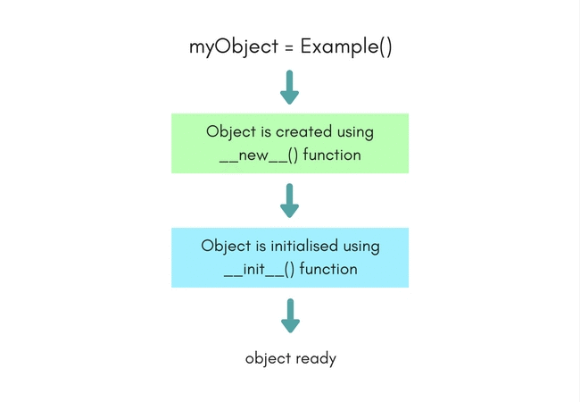

Slide 9
Inheritance in Python

Slide 10
Inheritance in Python
Inheritance is one of the most important aspects of Object Oriented Programming. While programming, many a times, situations arise where we have to write a few classes with some common features and some unique, class-specific features, which include both variables and methods.
In such situations, as per object oriented programming, we can take out the common part and put it in a separate class, and make all the other classes inherit this class, to use its methods and variables, hence reducing re-writing the common features in every class, again and again.
The class which inherits another class is generally known as the Child class, while the class which is inherited by other classes is called as the Parent class.
Ofcourse, you must only use this for the related classes only, for example, you can define a class LivingOrganism with all the basic features of a living organism defined in it, like breathe, eat etc. Now this class can easily be re-used by another class Animals and HumanBeings, as both of these shares the features.
Also, at times, Inheritance is used to simplify big classes with a lot of variables and methods, into smaller classes by breaking down the functionality into core features and secondary features. The core features are generally kept in the parent class.

Slide 11
Time for an Example
Let's take simple example. Animals can be divided into multiple types like reptiles, mammals, amphibians etc. While they all are different physically and biologically, there are many characteristics that are common amongst them. So now, we will define a parent class with name Animal, which will have some basic properties and functions related to animals.
And then we will define classes for various other types, and all those classes will also inherit the class Animal.
Here we have the Animal class.
class Animal:
# properties
multicellular = True
# Eukaryotic means Cells with Nucleus
eukaryotic = True
# functions
def breath()
def feed()

Slide 12
Now let's define a class for Mammals. As mammals are animals with warm blood, who produce milk for their infants etc, hence our Mammal class will look like,
class Mammal(Animal):
# properties
haveMammaryGland = True
def warmBlood = True
# functions
def produceMilk()

Slide 13
In case we want to create another class for Amphibians too, then
class Amphibian(Animal):
# properties
liveInWater = True
# functions
def metamorphosis()
As the classes Mammals and Amphibian both inherit the class Animal, hence they will have the properties and functions defined in the class Animal.
Hence, now any object of Amphibian class, say Frog, will have the properties: multicellular(from class Animal), eukaryotic(from class Animal), liveInWater(from class Amphibian), and would be able to breath(), feed() and do metamorphosis().

Slide 14

And how all this can be written as code, if we create an object, say Frog:
>>> Amphibian Frog = Amphibian()
>>> Frog.breath() # calling function defined in Animal class
>>> Frog.metamorphosis() # calling function defined in Amphibian class
>>> print Frog.liveInWater
Benefits of using Inheritance
Here are a few main advantages of using Inheritance in your programs.
Less code repeatition, as the code which is common can be placed in the parent class, hence making it available to all the child classes.
Structured Code: By dividing the code into classes, we can structure our software better by dividing functionality into classes.
Make the code more scalable.

Slide 15
Accessing Parent Class Element in Child Class
While working in a child class, at some point you may have to use parent class's properties or functions. In order to access parent class's elements you can use the dot . operator.
Parent.variableName
Mentioned above is how you can access the variable, or in case you need to call parent class's function then,
Parent.functionName()
Where Parent is the name of our parent class, and variableName and functionName() are its variable and function respectively.
Below is an example, we have a simple example to demonstrate this:
class Parent:
var1 = 1
def func1(self):
# do something here
class Child(Parent):
var2 = 2
def func2(self):
# do something here too
# time to use var1 from 'Parent'
myVar = Parent.var1 + 10
return myVar

Slide 16
METHOD OVERRIDING

Slide 17
Python Method Overriding Example
There is a parent class named Animal:
class Animal:
# properties
multicellular = True
# Eukaryotic means Cells with Nucleus
eukaryotic = True
# function breathe
def breathe(self):
print("I breathe oxygen.")
# function feed
def feed(self):
print("I eat food.")

Slide 18
Let's create a child class Herbivorous which will extend the
class Herbivorous(Animal):
# function feed
def feed(self):
print("I eat only plants. I am vegetarian.")
In the child class Herbivorous we have overridden the method feed().

Slide 19
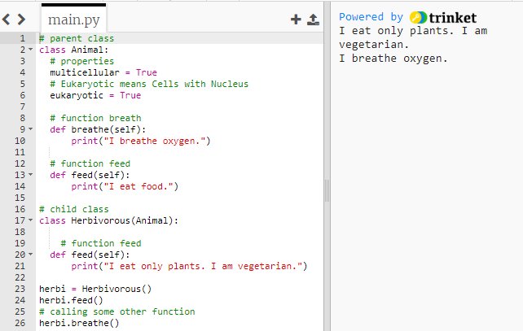
So now when we create an object of the class Herbivorous and call the method feed() the overridden version will be executed.
herbi = Herbivorous()
herbi.feed()
# calling some other function
herbi.breathe()

